Slide 1

Mrs K Stokes – Assistant Head (Teaching and Learning)
Mrs A Kopsidas – Assistant Head (Behaviour and Culture)

Slide 2
Our Rewards System
At KSHS we believe in rewarding outstanding effort as well as attainment. Students are rewarded in a variety of ways:
Individual Rewards:
Subject Awards
Growth Mindset Awards
Merits – Bronze, Silver, Gold and Platinum awards
Termly Prize Draw
100% Attendance Certificates
Form Rewards:
Highest overall merits
Highest overall attendance

Slide 3
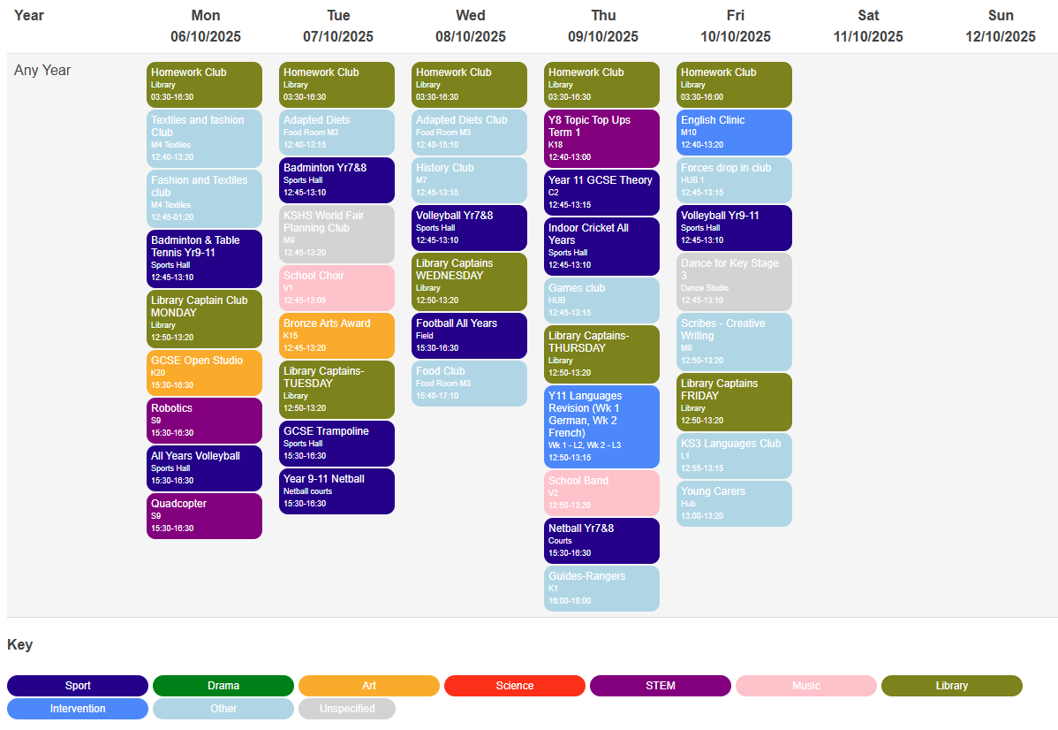
Our extra-curricular Offer
At KSHS we offer over 54 clubs for students across KS3 & 4
We value highly the skills and cultural capital that extra-curricular involvement can give young people
There really is something for everyone
Notes:
From Biology to Music, Performing Art and Netball to Lego club. At KSHS we have a huge variety of clubs – totally 54 per week for students. Some of these clubs have restrictions eg: GCSE French revision, but your young people will be able to join a club to learn something new, or to do something they already enjoy. The Fresher's Fair is always a very lively afternoon, and we hope that your young person managed to sign up. If there is a gap 'in the market' - staff are open to suggestions of clubs that students would like to see on our extra-curricular offer.

Slide 4
Educational Visits
Year 7 - Residential Trip (TBC)
Year 7 - Maths trip to Bletchley Park
Year 7 – Geography field work trip to Skegness
Year 7 – Alice in Wonderland Theatre Trip
Year 8 - History Trip to Burghley House
Year 8 – Residential Trip (TBC)
Year 9 – France and Belgium History and MFL Trip
Year 9 – Science National Space Centre Trip
Year 10 – Geography Field work trip to Birmingham
Year 10 – History case study Lincoln Castle trip
Year 11 – Geography fieldwork in Hunstanton
Year 11 - English Poetry Live trip
Year 11 – Drama Residential trip including productions and workshops
Year 11 – MFL and History Trip to Berlin
Other curriculum-based trips are offered in option subjects when opportunity presents
Notes:
These are the curriculum and non-curriculum trips on the School Calendar so far this year. This does not include the in-school activities for STEM/Maths/Science and PSHE that students take part in, D of E Residentials, trips run by clubs, sports fixtures, and any trips that will be added throughout the year. Trips are run on staff goodwill, particularly residentials, and are offered as a reward for students effort and hard work during the academic year. All of our trips are inclusive, meaning that, where possible, they are open to all students.

Slide 5
Pupil Premium Support
The Pupil Premium is additional funding given to schools so that they can support their disadvantaged pupils and close the attainment gap between them and their peers.
Support for individuals at KSHS includes:
Revision guides and equipment for lessons
Financial support for music lessons and school trips
£120 towards transport and/or uniform costs
Our Pupil Premium Strategy can be found on the website

Slide 6

Helpful conversations at home
Equipment – including ruler, green pen and whiteboard pen
Lockers – time at break and lunchtime to avoid heavy bags
Use of planners and homework – building organisational skills
Monitoring use of AI for homework etc.
Talking about how to learn

Slide 7

“Whoever does the thinking gets the learning.”

Slide 8
What can I do at home?
Transition - What can I do at home?
Find time to talk, just the two of you – ‘Check in’ with them while you’re doing things together, so they get used to talking about their feelings.
01
Spend time together (play games together) – Play helps them to be curious, learn new things, solve problems and express feelings without words.
02
Be a role model – Show how you cope with difficult feelings and look after yourself.
03

Slide 9
Staying Safe Online
UK child internet users aged 8-14 spent an average of 2 hours 59 minutes a day online across smartphone, tablet and computer. – with girls spending more time online than boys on the devices that were monitored.
The services that children spent most time on were YouTube and Snapchat – combined, they accounted for over half (52%, 1 hour 31 minutes) of the average time spent by UK 8-14-year-olds per day.
According to internet matters 50% of parents feel pressured into allowing their child screentime so that their child doesn't miss out.
26 June 2025 report:
Top trends from our latest look at UK children’s online lives - Ofcom

Slide 10
Keeping Safe Survey, of those who responded…
40% viewed or been sent harmful content online
46% of this occurred on snapchat
25% had been contacted by a stranger
49% of these had occurred on snapchat
Only 35% of parents have parental controls
50% of grooming cases are via snapchat.
Average age young people are accessing
inappropriate material is aged 12.

Slide 11
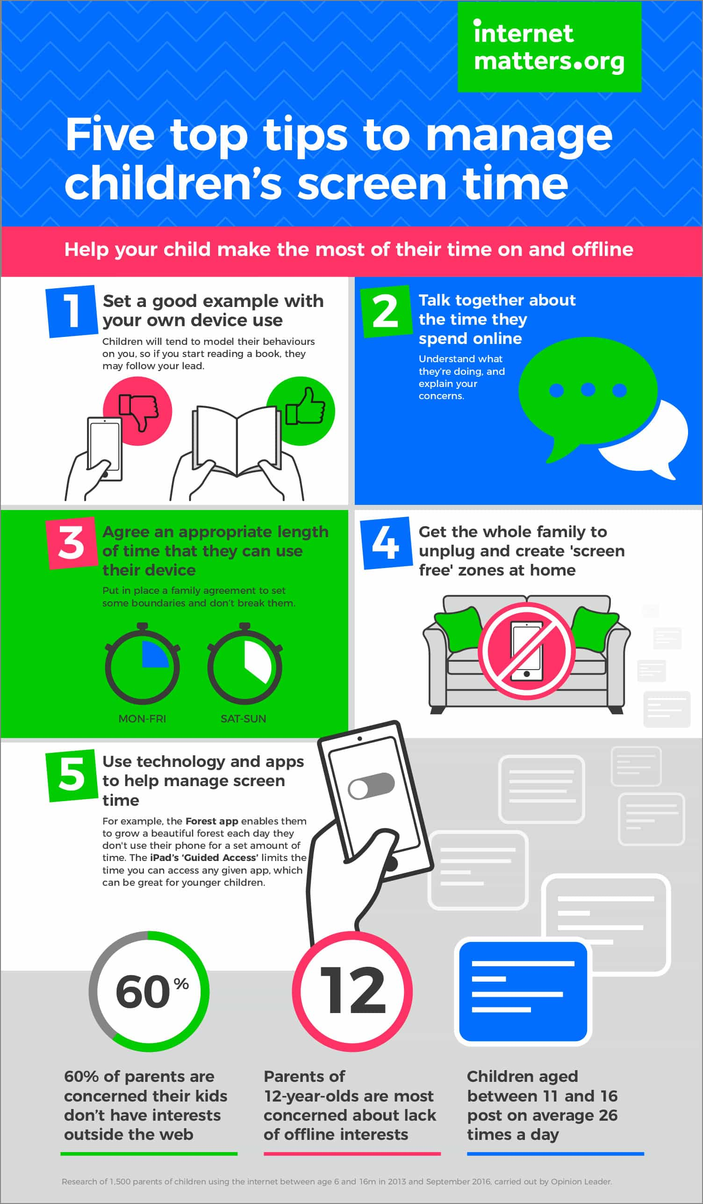
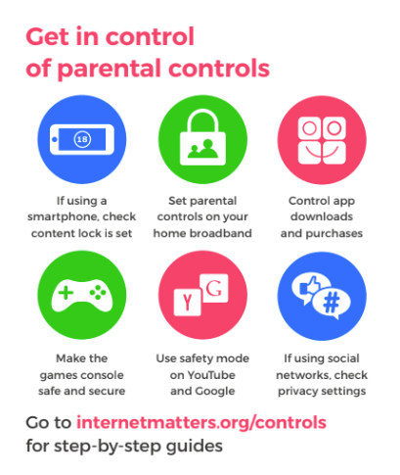

Slide 12
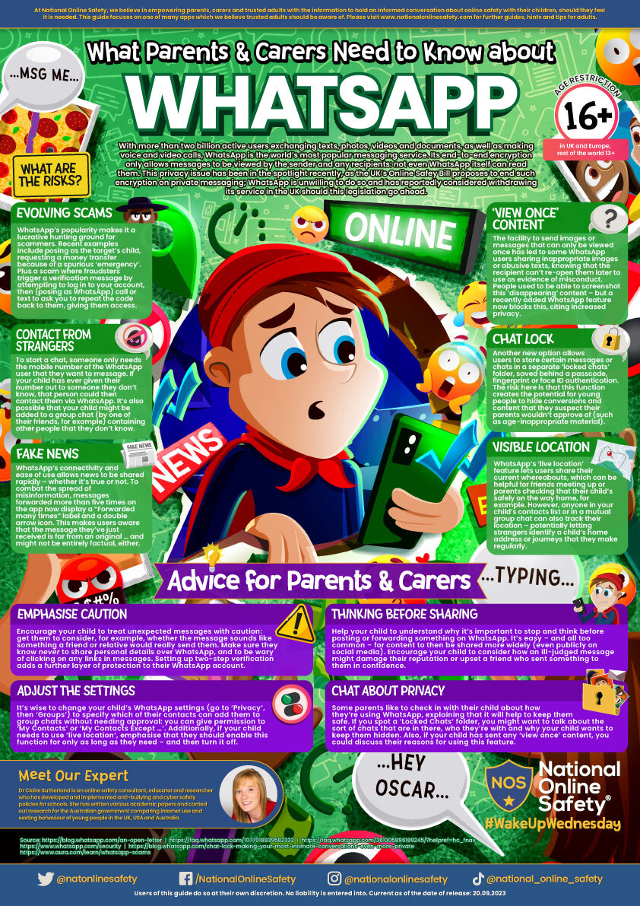
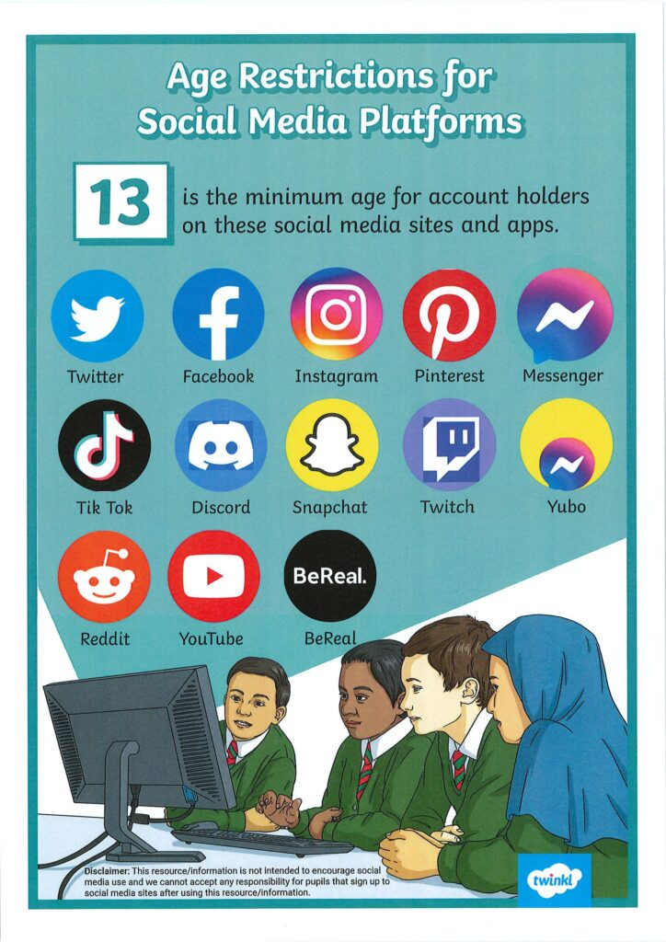
Parental Controls & Privacy Settings Guides - Internet Matters
April 2024 – changed from 16+ to 13+

Slide 13



Recommended Reading
Some recommended reading

Slide 14

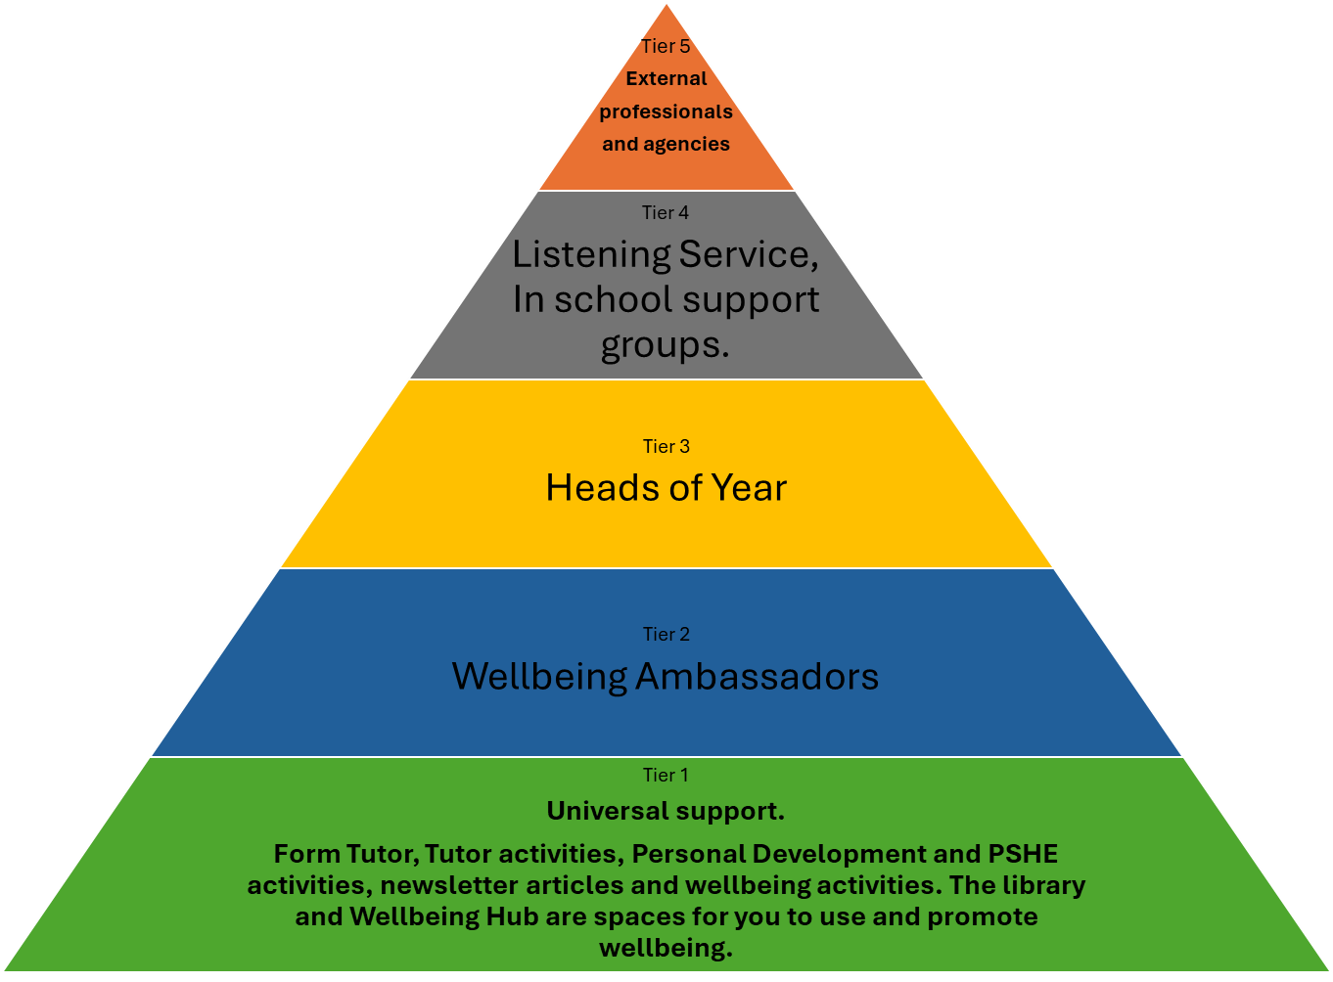
Where can you go for help?
KSHS
5 tiers of support

